Slide 1
Storytelling with data in Tableau
Instructor: Mallikarjun PM
Facilitated by: Xaltius Pte Ltd

Slide 2

About the instructor
Day Job: Data Scientist, IAG Firemark Labs
Loves to solve problems and build solutions using tech, has a data-first oriented mindset.
A hobbyist photographer and travel enthusiast.

Slide 3

What’s in this session ?
Need for Business Intelligence
What exactly is storytelling with data
Basic terminologies
Practical hands-on

Slide 4


Need for Business Intelligence
A method of making informed decisions using data
Can be applied across all industries and at any scale

Slide 5
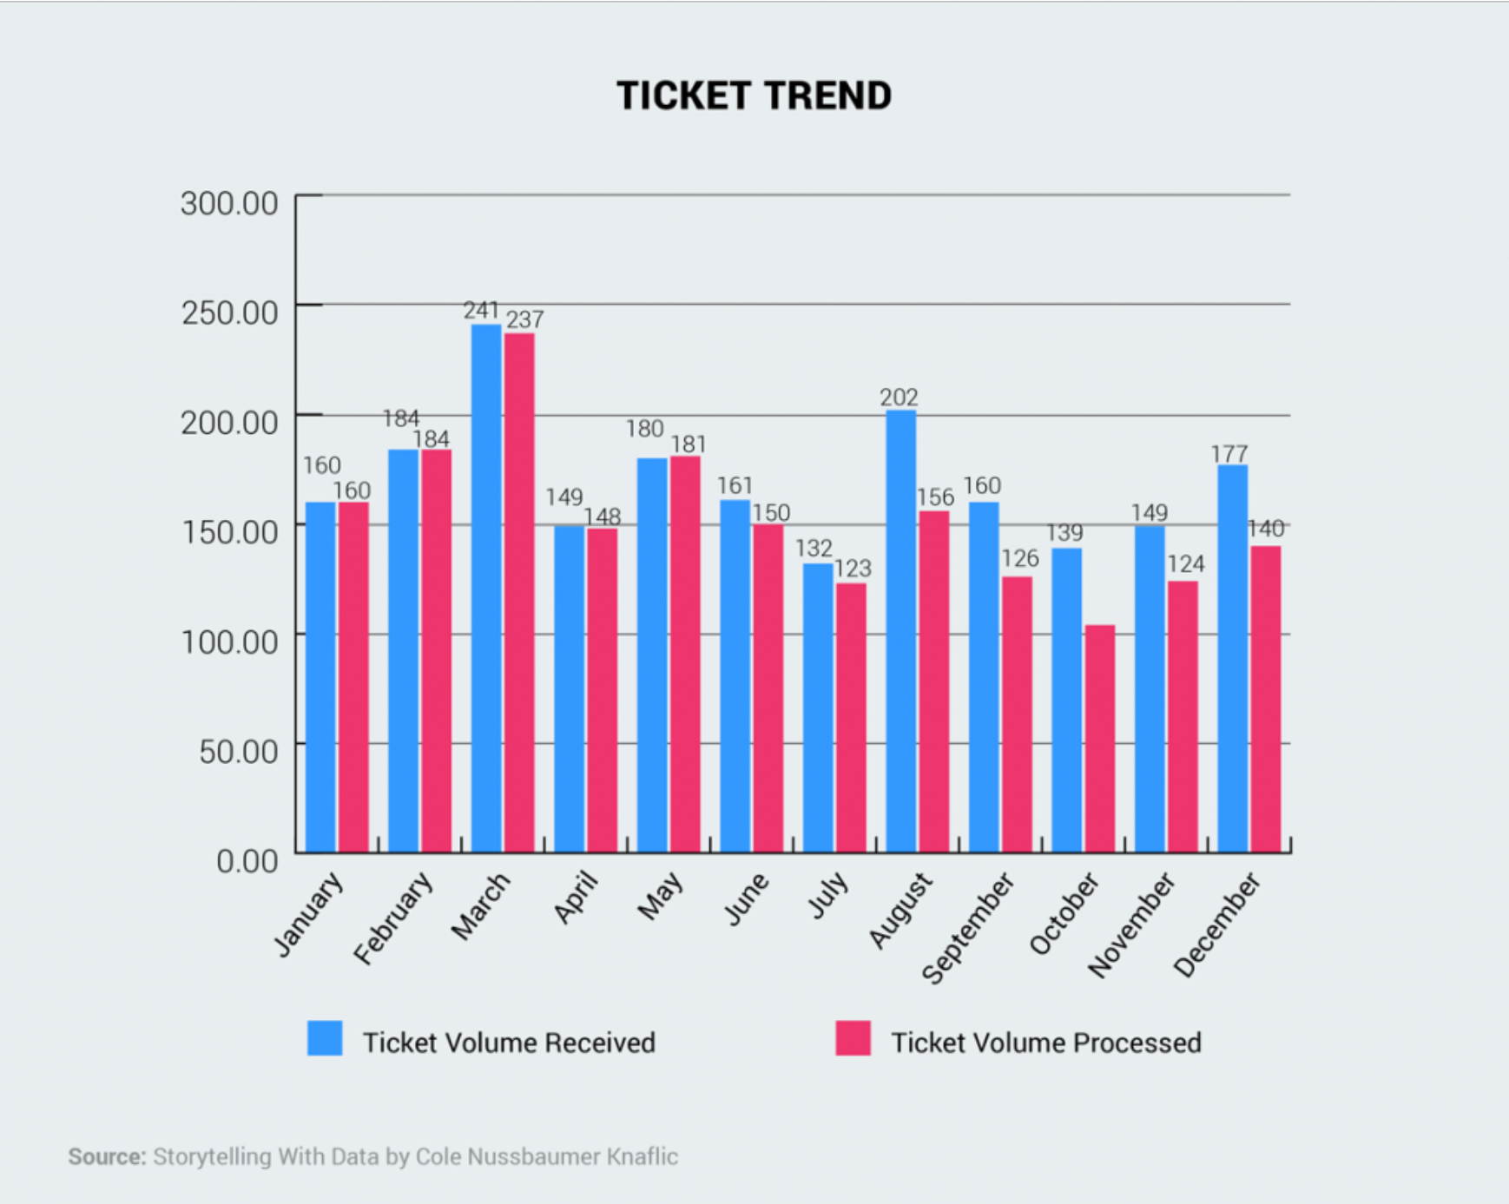
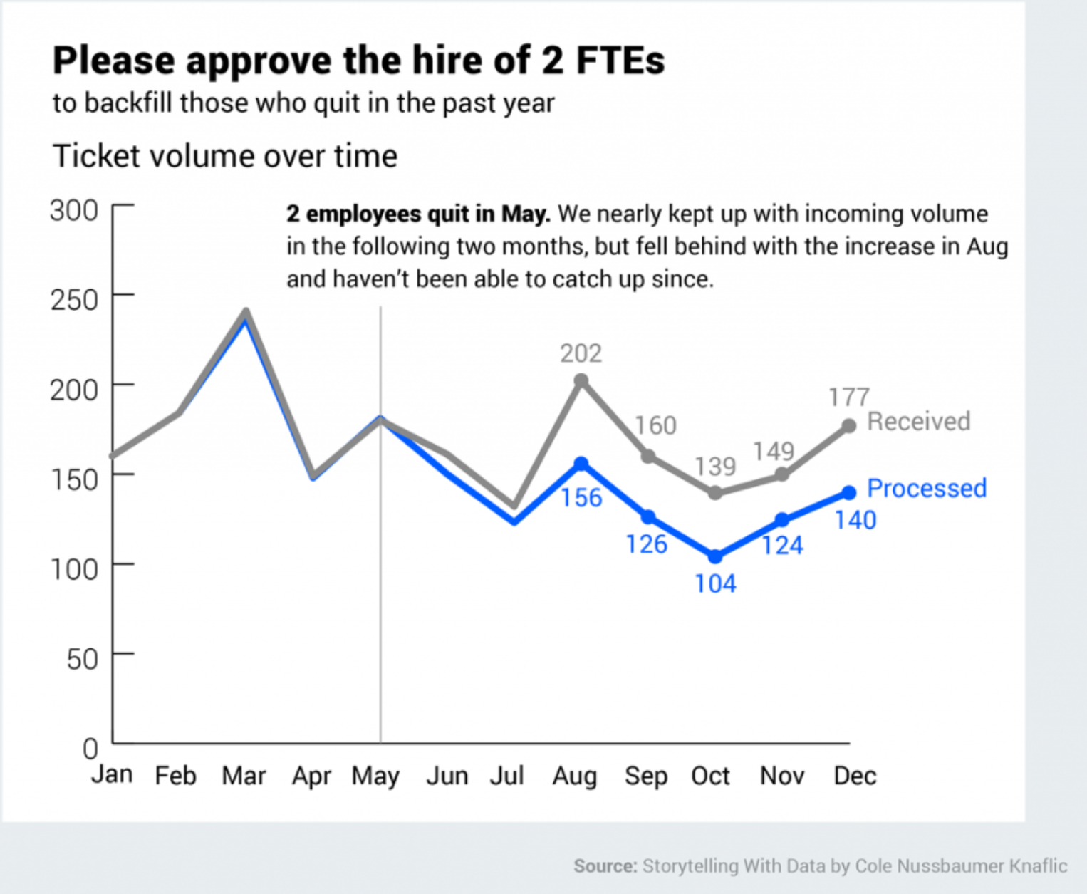
What is storytelling with data?
Communicating your findings from data using the right metrics, KPIs and intuitive visualizations
The visualization should and must convey a specific and clear message
Notes:
TASK: Identify the right vs wrong way of presenting data
Any students of business process management have a different idea?

Slide 6
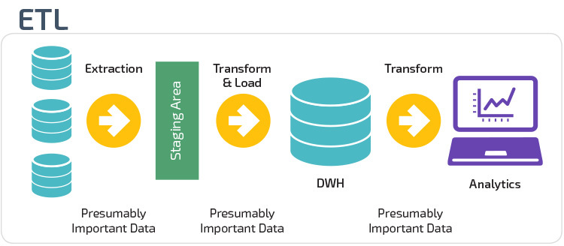
Basic Terminologies I - ETL
Notes:
All the data pre-processing and manipulation/aggregation should be ideally handled by backend tool. Tableau is not efficient in data pre-processing and manipulation/aggregation.

Slide 7
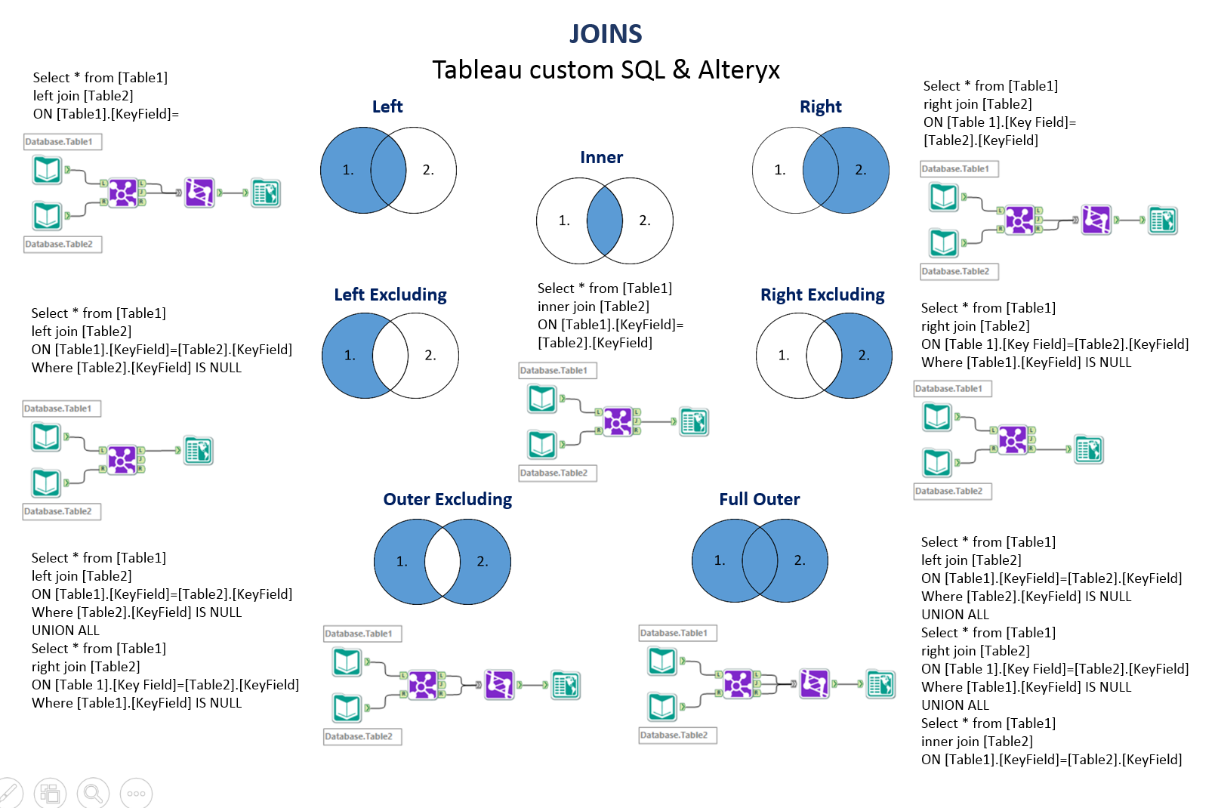
Basic Terminologies II - Joins

Slide 8
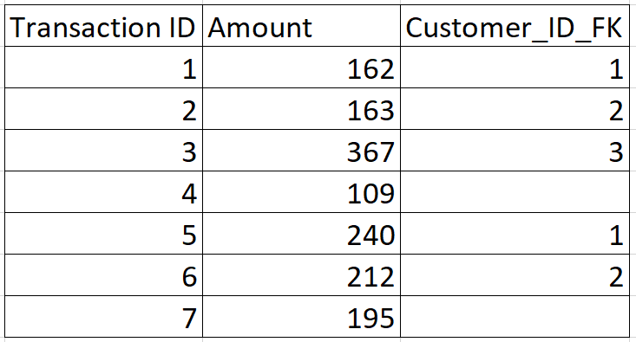
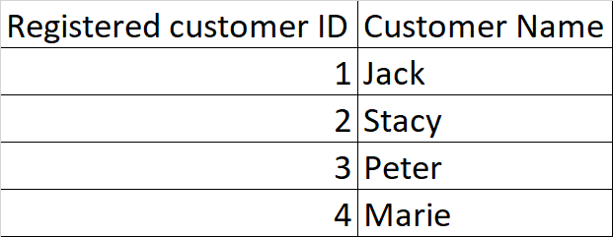
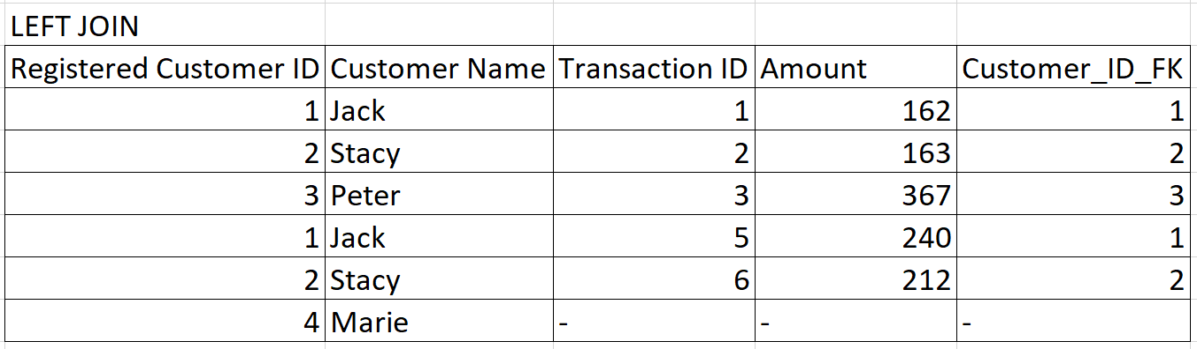

Slide 9
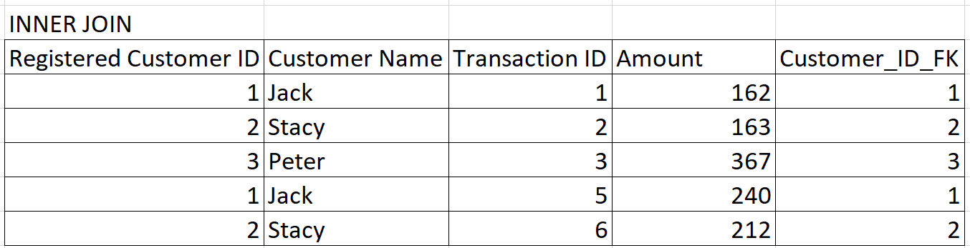

Slide 10
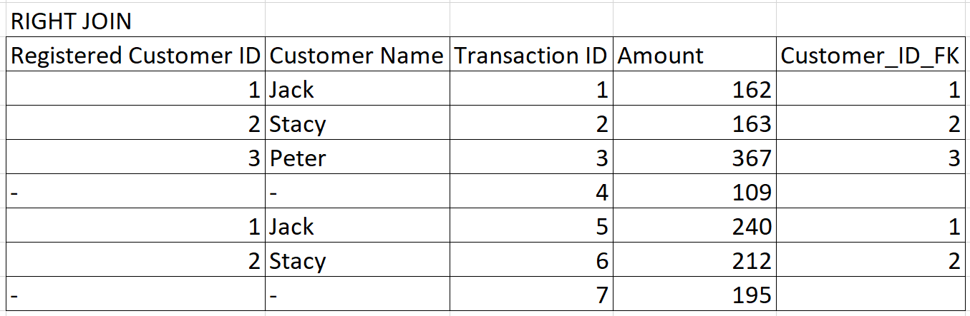

Slide 11
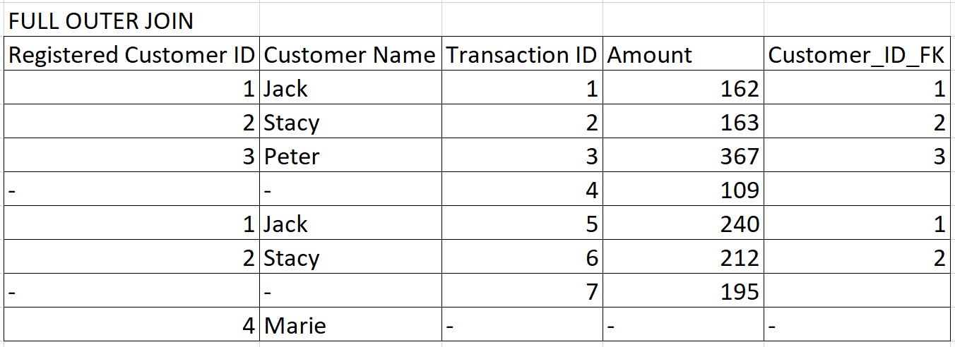

Slide 12
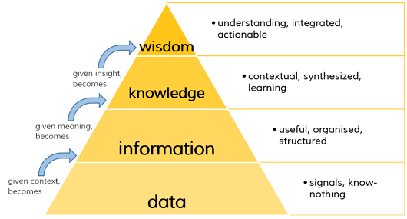
Basic Terminologies III
Dimension vs Measure
Discrete vs Continuous variables
Metric vs KPI - Profit vs % Profit per store
The DIKW pyramid
Notes:
Dimension (cannot be quantified) - Date, Measure (can be quantified) – no. of hours
Discrete - number of siblings, continuous – height
Metric – measure, KPI – measure with a reference point for subsequent comparison

Slide 13
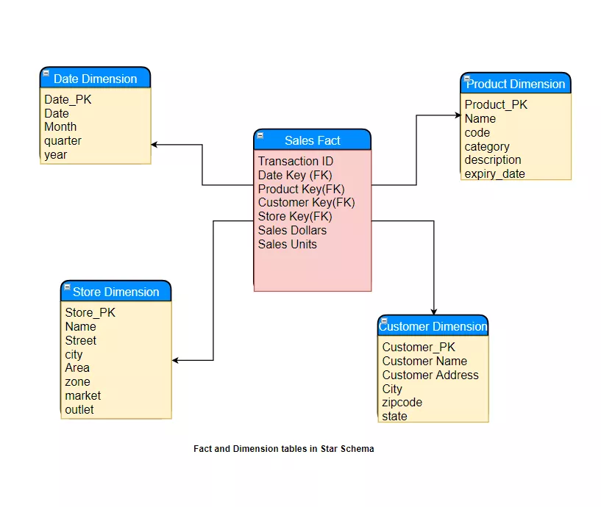
Basic Terminologies IV - Data Warehouse
Data Warehouse Star Schema

Slide 14
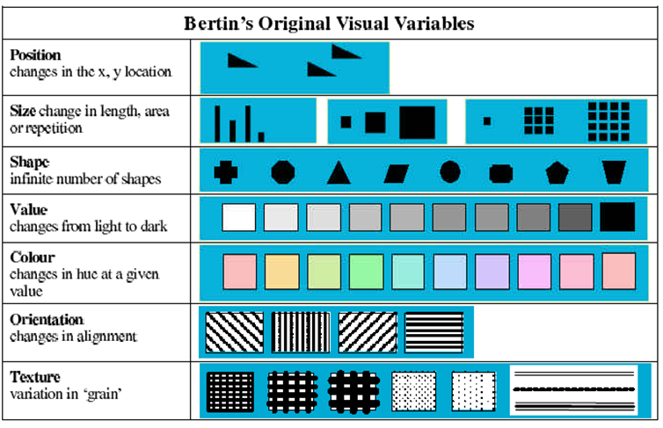
Bertin’s 7 Visual Variables
Notes:
orientation - wind direction
texture - forest vs urban

Slide 15
Charts and where to use them
Notes:
https://interworks.com/blog/ccapitula/2014/08/04/tableau-essentials-chart-types-introduction/

Slide 16
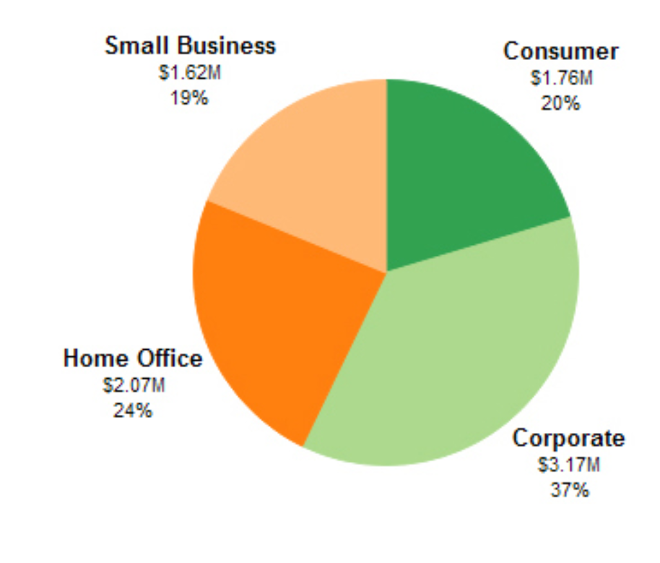
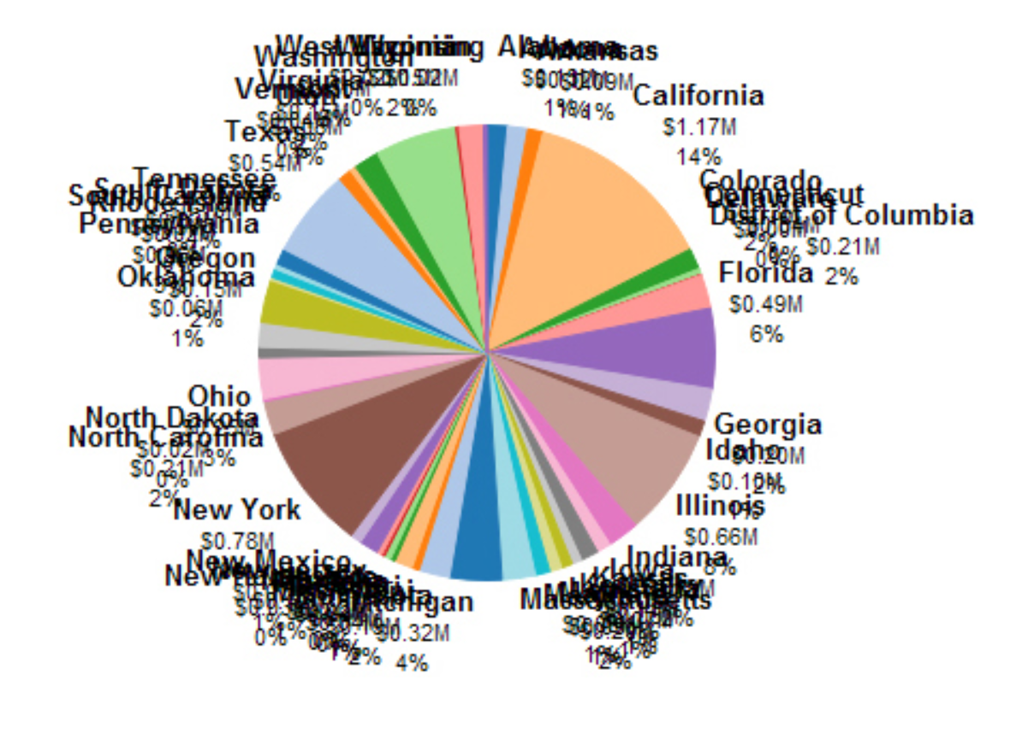
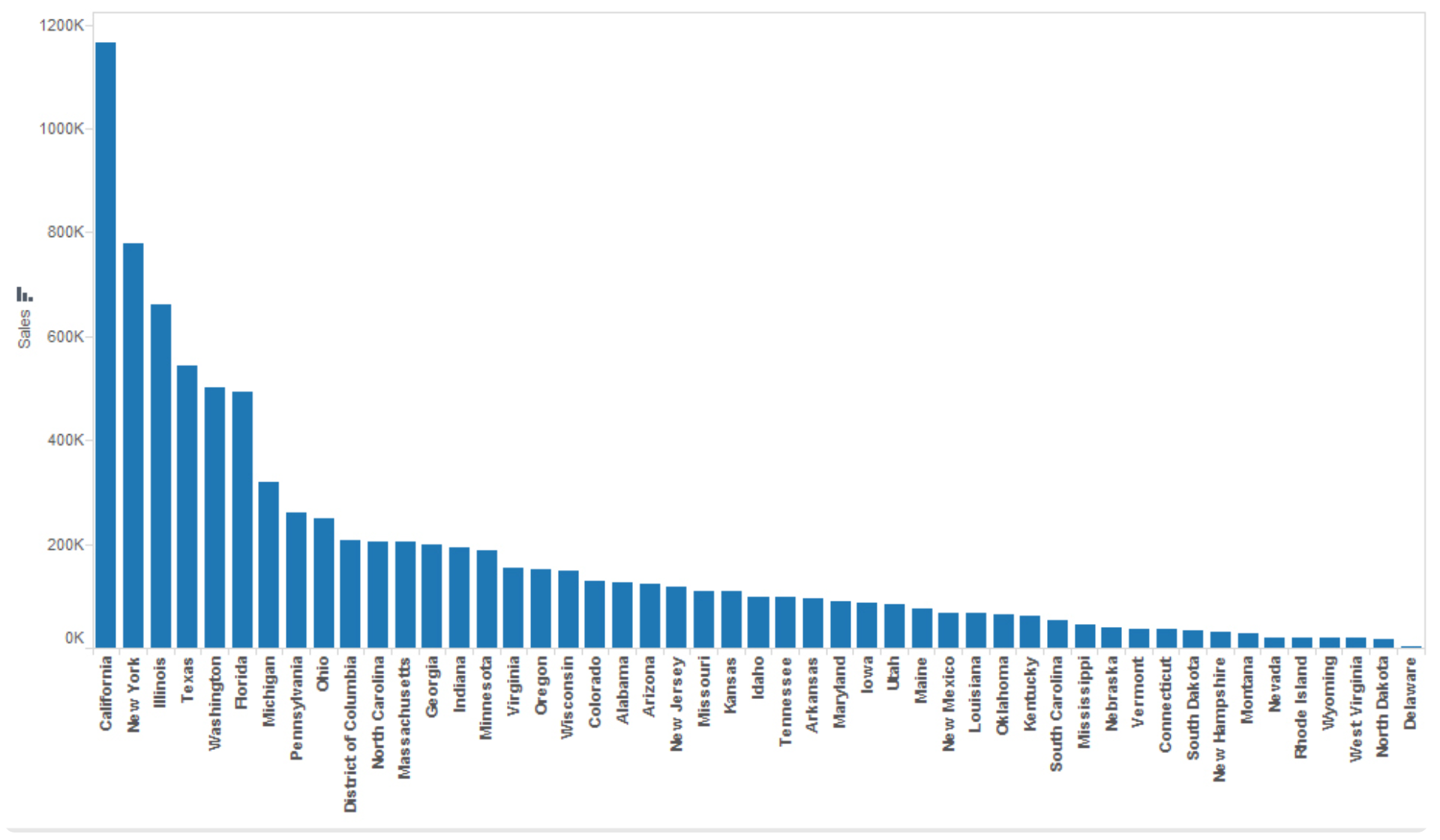
Pie Charts
Best suited to show proportional or percentage relationships.
When used appropriately, pie charts can quickly show relative value to the other data points in the measure.
Tableau recommends that users limit pie wedges to six

Slide 17
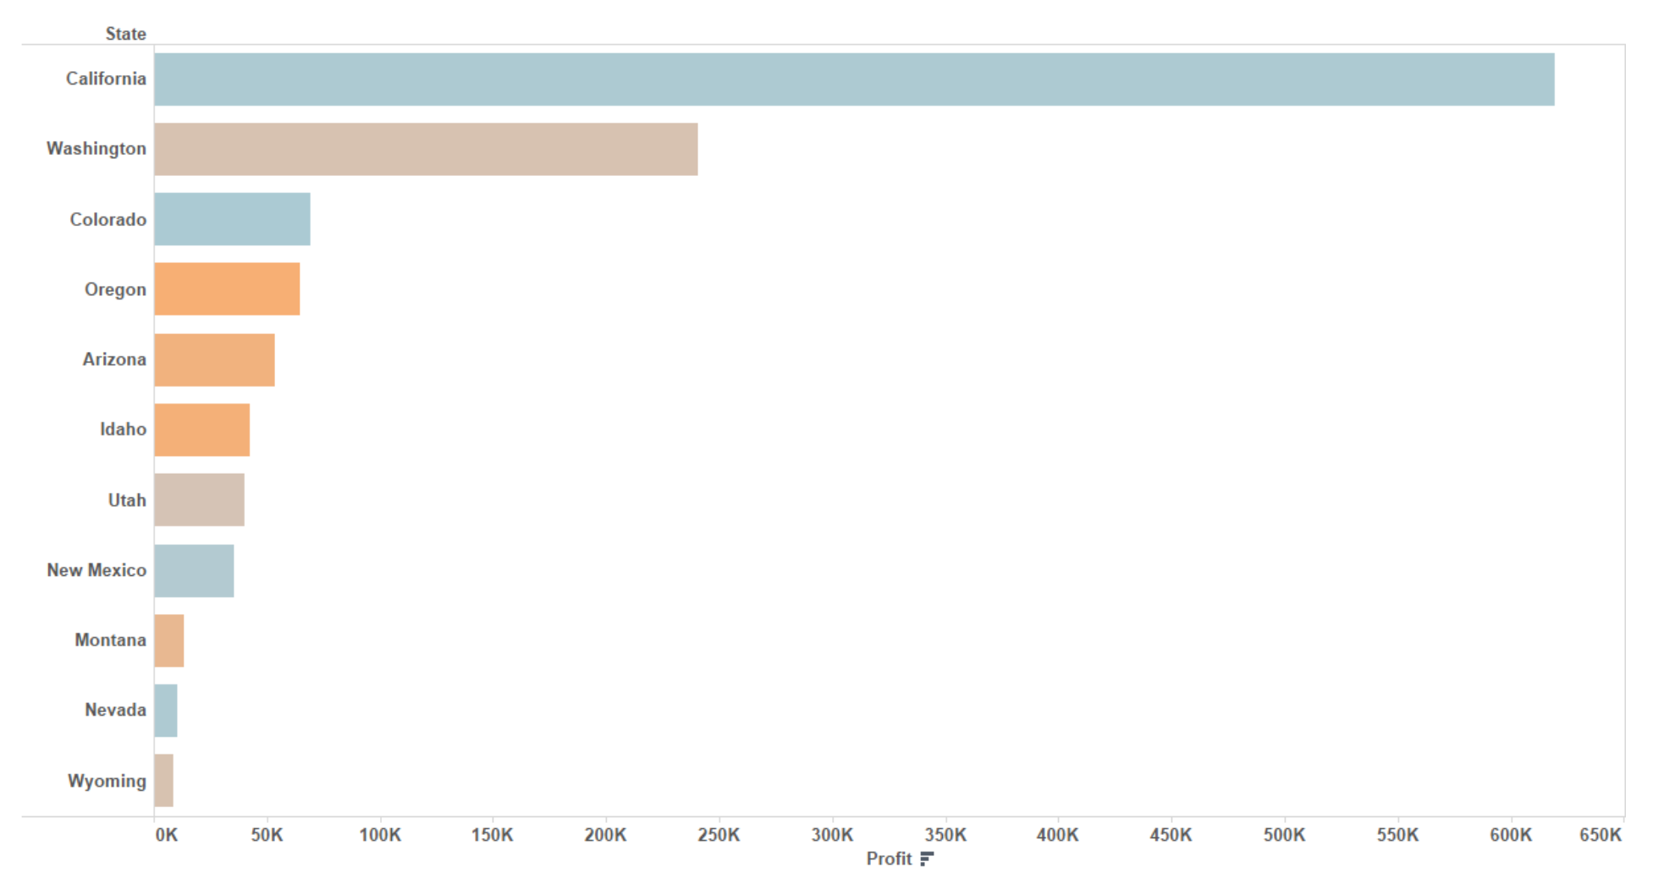
Horizontal Bar Charts
It makes data really digestible and tells a good story.
We can easily see which categories have higher numbers compared to other categories.
Minimum Requirements: 0 or more dimensions, 1 or more measures

Slide 18
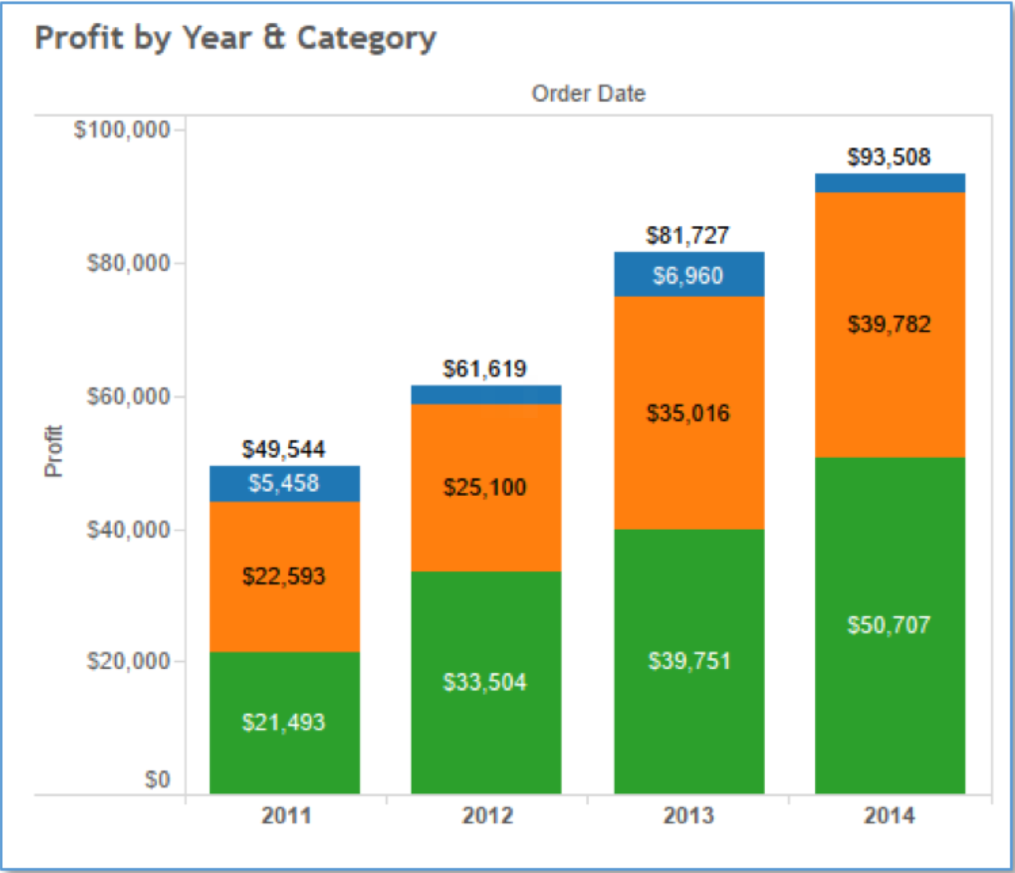
Stacked Bar Chart
You can use the stacked bar chart to show data in categories that are also stratified into sub-categories.
It allows us to see more details than the regular bar chart would provide.
Minimum Requirements: 1 or more dimensions, 1 or more measures

Slide 19
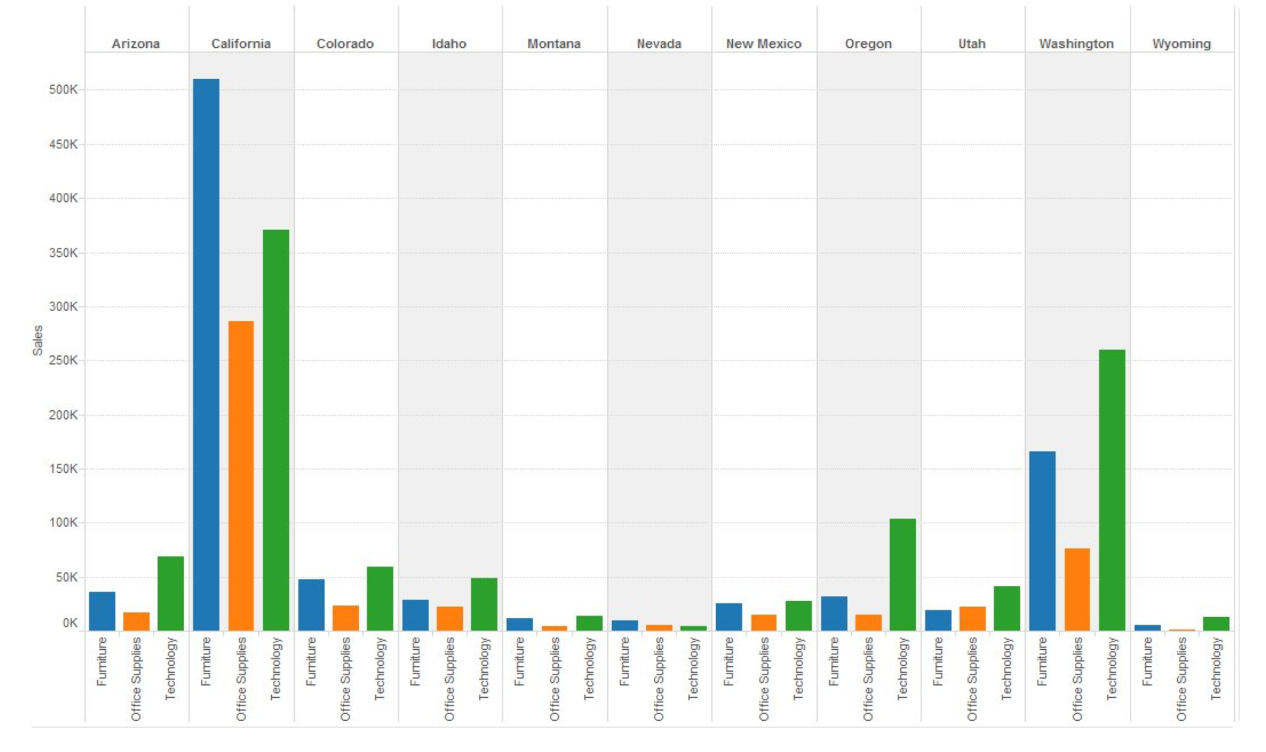
Side by Side Bar Chart
Show a side by side comparison of data.
The side-by-side bar chart is similar to the stacked bar chart except that it is un-stacked the bars and put the bars side by side along the horizontal axis.
Minimum Requirements: 1 or more dimensions, 1 or more measures

Slide 20
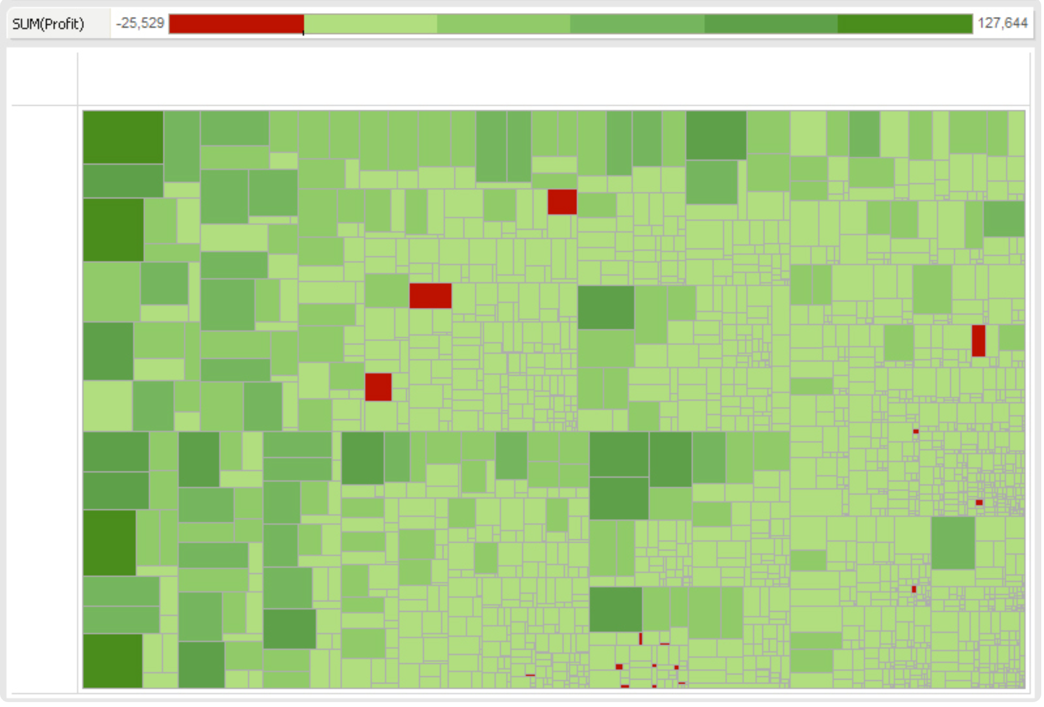
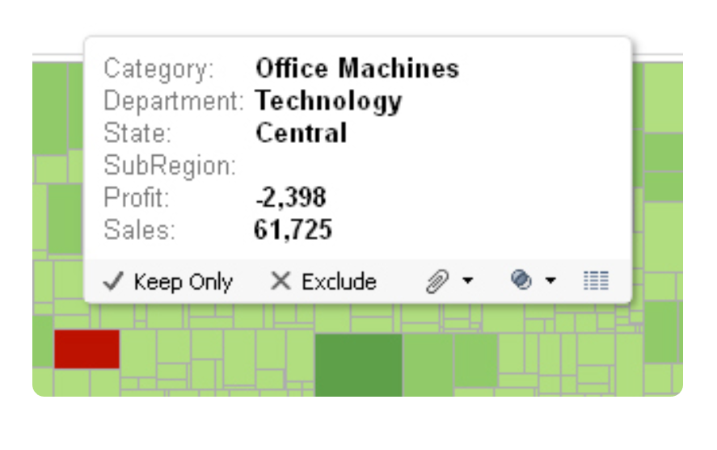
Treemap
Use a treemap to show hierarchical (tree-structured) data and part-to-whole relationships.
Treemapping is ideal for showing large amounts of items in a single visualization simultaneously.
Minimum Requirements: 1 or more dimensions, 1 or 2 measures

Slide 21
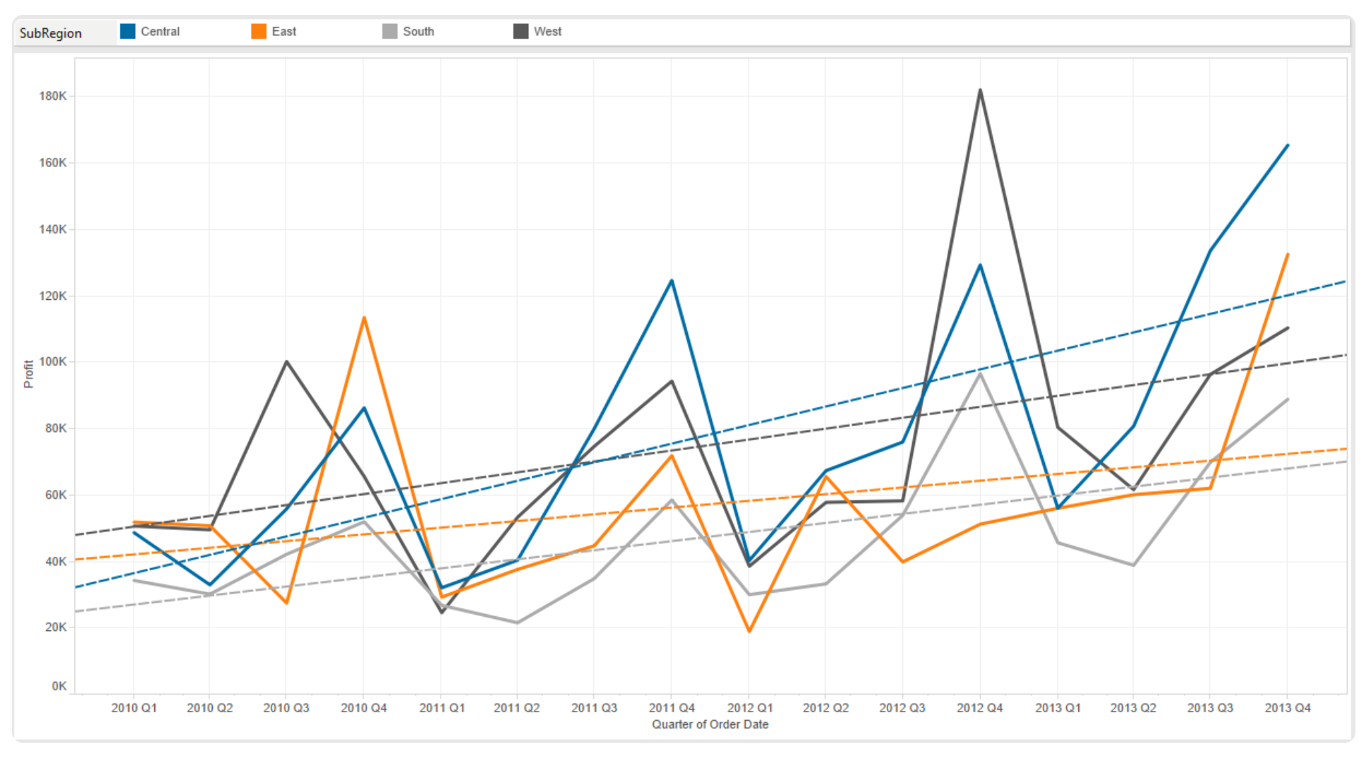
Line Chart (Continuous)
This is extremely helpful when you are trying to tell a story of how things changed over a period of time.
You can use several number of lines in the view to show continuous flow of data.
Minimum Requirements: 1 date, 0 or more dimensions, 1 or more measures

Slide 22
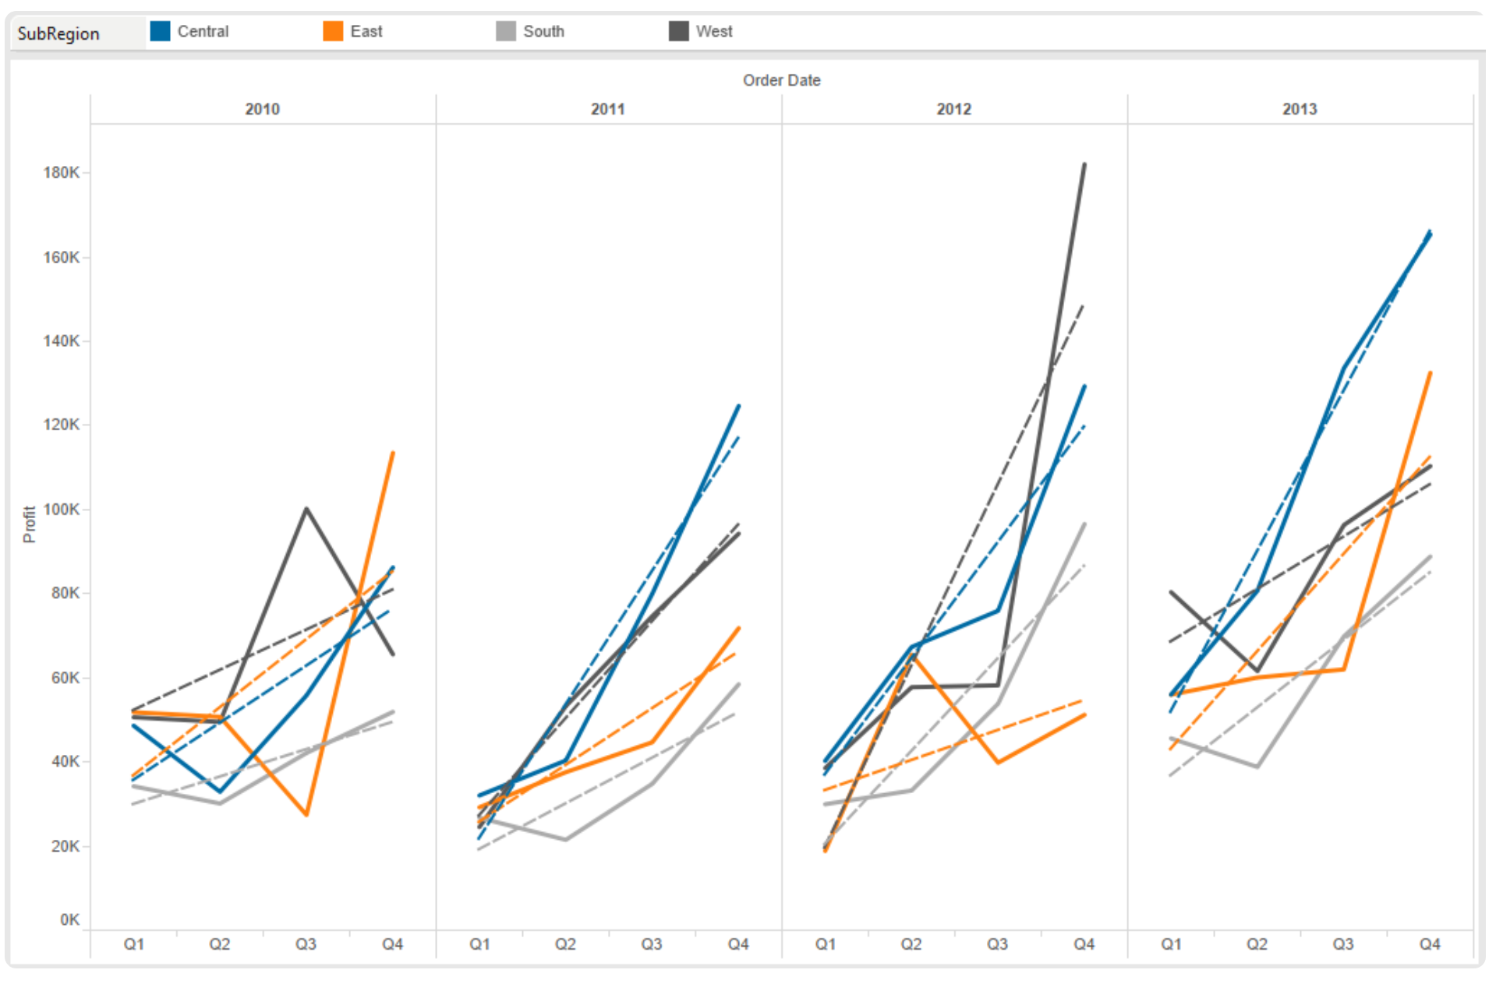
Line Chart (Discrete)
Must have a date field in order to use this graph.
The difference between the two is the type of data you are showing, discrete vs. continuous.
Slice and dice the graph for deeper analysis.
Minimum Requirements: 1 date, 0 or more dimensions, 1 or more measures

Slide 23
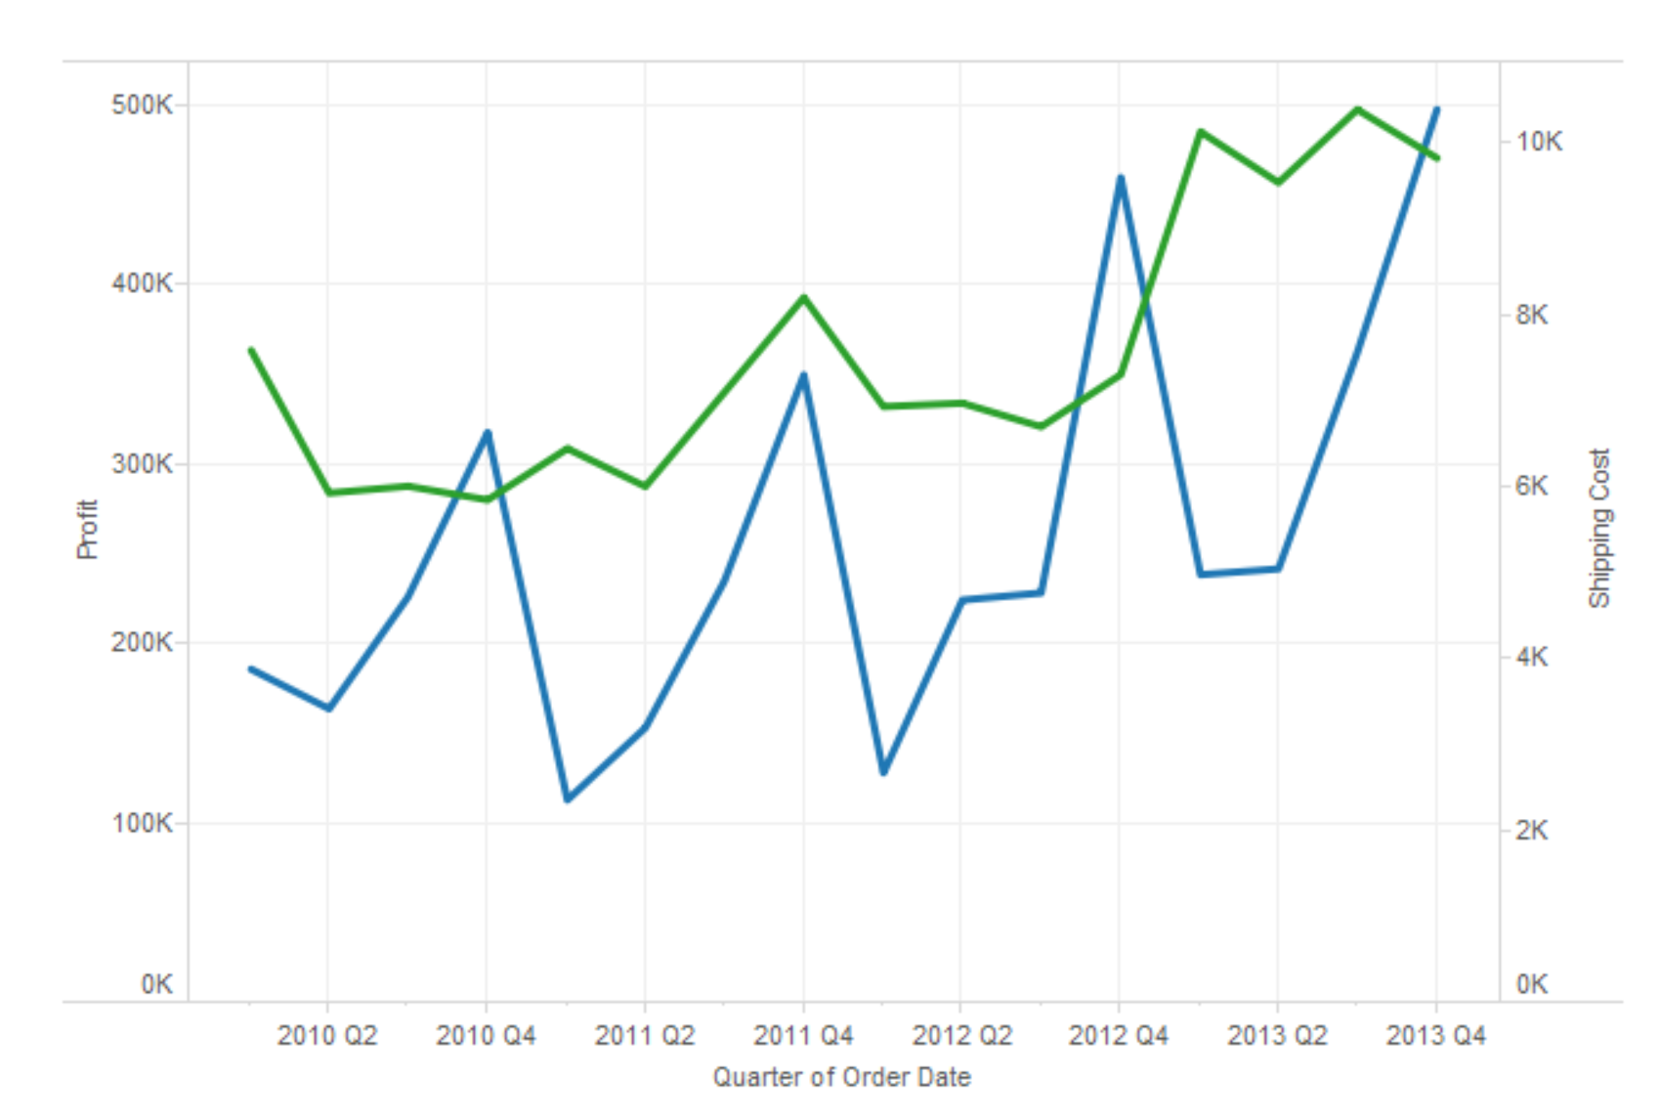
Dual Line Chart
Use when comparing two measures over a period of time
This view produces unsynchronized axis . It allows for more than one measure to be represented with two different axis ranges.
Minimum Requirements: 1 date, 0 or more dimensions, 2 measures

Slide 24
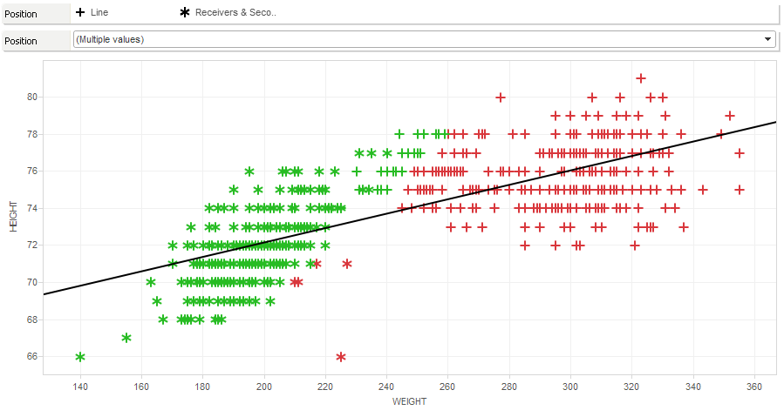
Scatterplots
Are great for comparing two different measures and identifying patterns.
The scatter plot also uses symbols to visualize data.
In a scatter plot, both axes in the chart are measures rather than dimensions.
You can add a trend line into scatter plots; this will clearly define the correlation among your data
Minimum Requirements: 0 or more dimensions, 2–4 measures

Slide 25
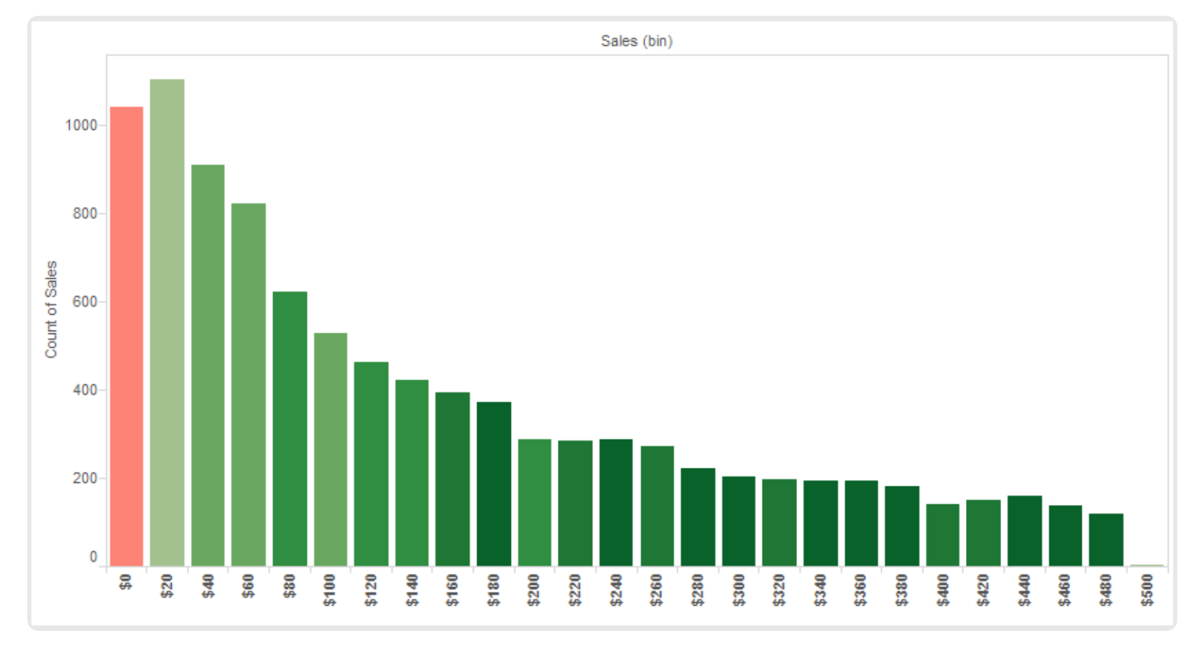
Histogram
A histogram is a visual representation of the distribution of data.
This is very useful when you want to analyze how the data is distributed.
Minimum Requirements: 1 measure (bin field)

Slide 26

Storytelling in action

Slide 27

Practical Hands-On
Dataset : Global Superstore
Visualization Tool : Tableau Desktop
Choose your metrics and KPIs wisely !

Slide 28
Resources
https://www.dummies.com/programming/big-data/big-data-visualization/tableau-for-dummies-cheat-sheet/
https://interworks.com/blog/ccapitula/2014/08/04/tableau-essentials-chart-types-introduction/

Slide 29
Thank You
Questions?

